Slide 1
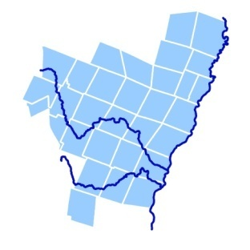
Putting Ecological Considerations into Zoning and Subdivision Bylaws
TRORC
Developed by the Two Rivers-Ottauquechee Regional Commission and funded by a grant from the Wellborn Ecology Fund

Slide 2
Why should bylaws be used to protect natural resources and ecosystems?
Because there are statutory requirements
Because natural resources are valuable to your residents
Because natural resources and ecosystems are an economic engine
Because they are part of the quality of life in Vermont

Slide 3
Town Plans and Bylaws
Land use bylaws must be in conformance with town plans by September 1, 2011.
Town plans must address 10 different elements (24 VSA 4382) including
    “ a statement of objectives, policies and programs of the municipality . . . to protect the environment.”
    “ a land use plan, consisting of a map and statement of present and prospective land uses, indicating those areas for forests, . . . and open spaces reserved for flood plain, wetland protection, or other conservation purposes.”
    “a statement of policies on the preservation of rare and irreplaceable natural areas, scenic and historic features and resources.

Slide 4
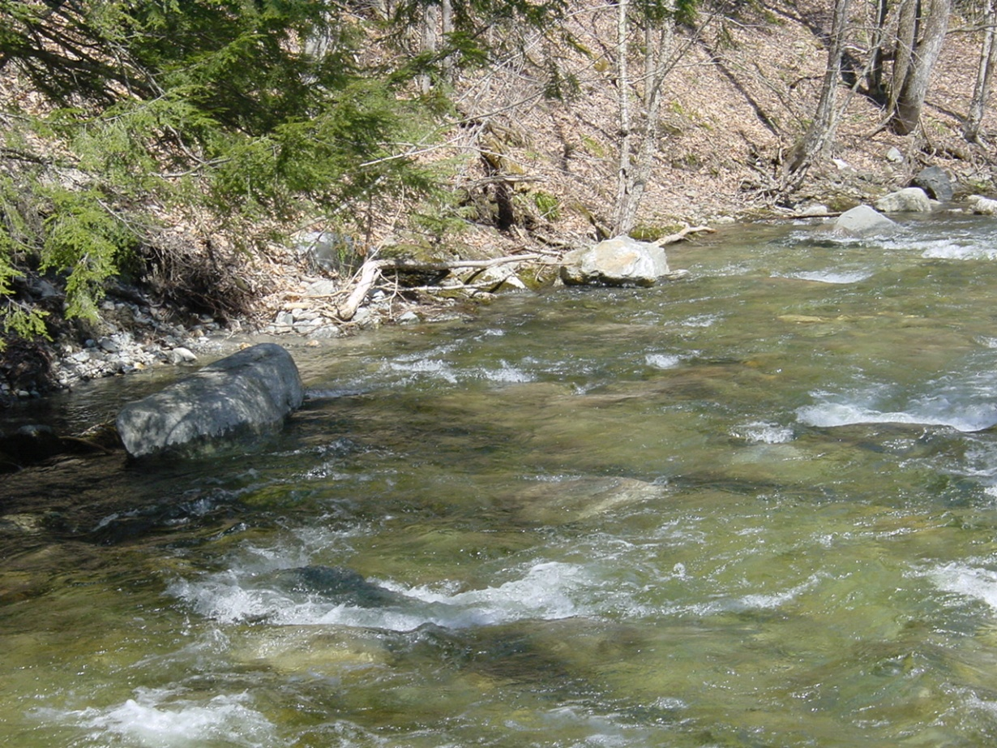
Bylaws and State Planning Goals
Vermont law also states (24 VSA section 4410) that bylaws (both zoning and subdivision) “are adopted for the purposes set forth in section 4302”, the most relevant being, “(6) to maintain and improve the quality of air, water, wildlife and land resources.”
So, do they?
Notes:
MUST be adopted to conform with goals

Slide 5
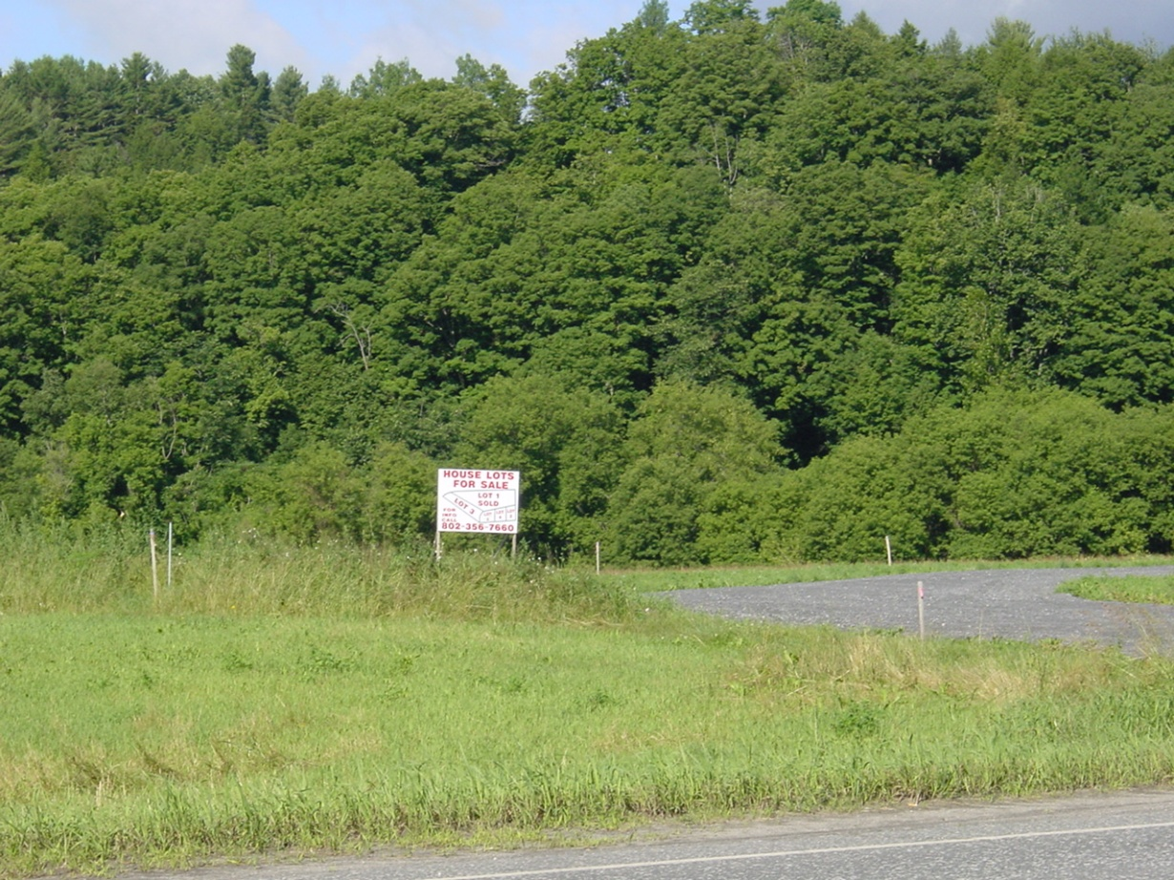
Subdivisions
Municipalities that adopt subdivision bylaws must include “standards for the protection of natural resources and cultural features and the preservation of open space, as appropriate in the municipality.” (24 VSA section 4481)

Slide 6

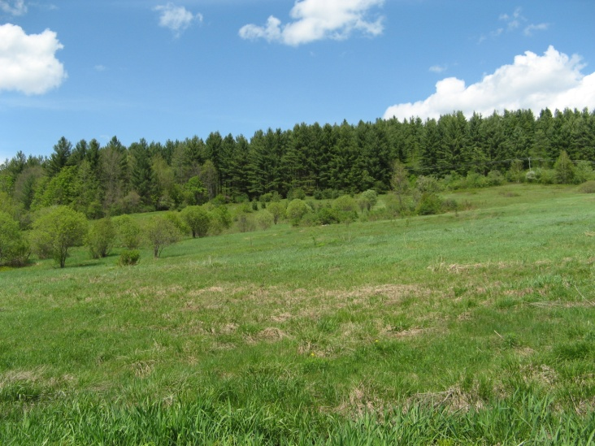
Nature’s Value
Natural systems provide “green infrastructure” or “environmental services” that are often not recognized because they are “free”, at least until you lose them.
Most drinking water in Vermont is not treated to make it drinkable, because Nature has already done so.
Nature absorbs our effluent and emissions.
Soil, rain and sunlight provide the basis for our food and wood.

Slide 7
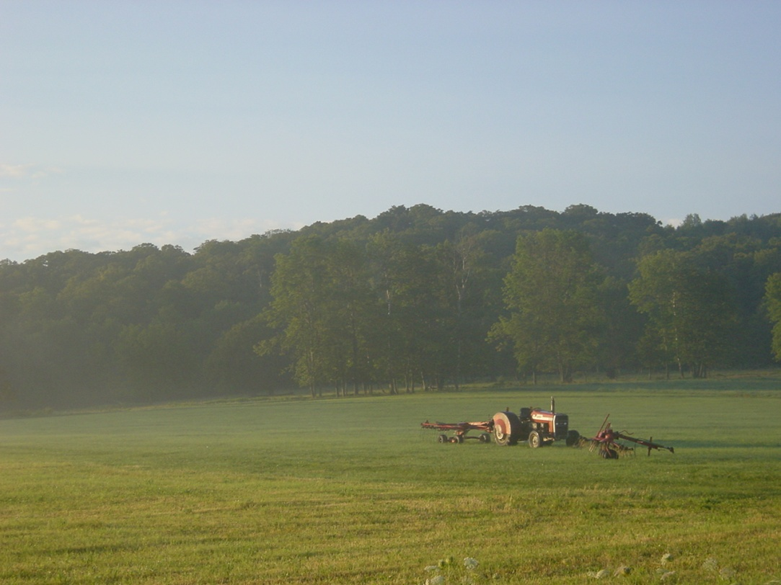
Vermont and its Quality of Life
Vermont is renowned for its rural landscape. National Geographic Traveler magazine named the state one of "the World's Greatest Destinations." This beauty drives tourism, an important industry, but also drives us to live here.
But this gift is ours to save or lose.
In 2004, the entire state was listed on the National Trust for Historic Preservation list of America's 11 Most Endangered Historic Places.

Slide 8
How can ecological values be protected during development review in zoning bylaws?
Districts
Overlays
General Standards
Site Plan Standards
Conditional Use Standards
Notes:
Ask: How many people from PCs? SBs? CCs?

Slide 9
A district is a defined area of land that has the same regulations throughout.
Districts begin with a purpose statement that establishes what the district is trying to achieve and is used in conditional use review as well.
Common district boundaries:
Roads (and set buffers from roads)
Streams
parcel boundaries
Less common boundaries:
contour lines, resource-based lines and hand-drawn lines.
Notes:
Resource based districts are hard for lay people to find on the ground – better for protection , nearly impossible to implement.

Slide 10
Using districts to protect ecological values
Areas with large amounts of any special natural resources and ill-suited to development could be proposed in the plan and zoned as a district. Examples include:
  Conservation District due to steep slopes, poor soils, aquifers, surface waters, wetlands, distance from roads, flood potential, etc.
  Working Lands District that prioritize farming and forestry
  Low Density Residential District with density provisions
Notes:
For example, Chateauguay. Other areas in Rutland?

Slide 11
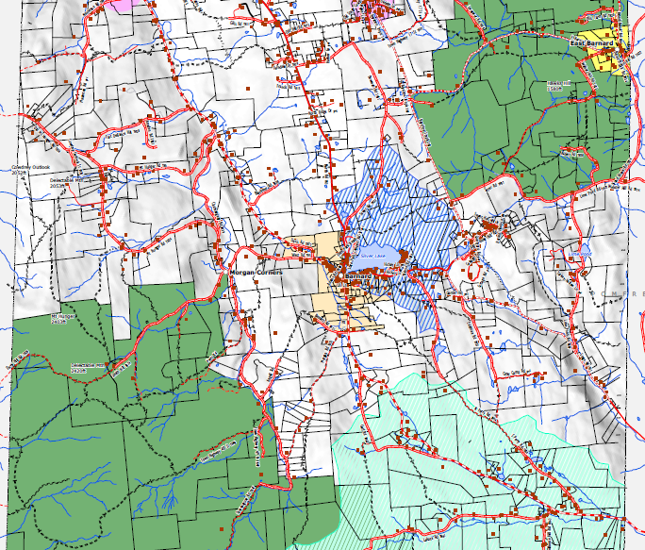
Conservation District
District has public lands, large lots, lands in Current Use or parcels under conservation easement. District is also poorly served by Class 3 or better town roads.
Notes:
Can customize the map to each RPC

Slide 12
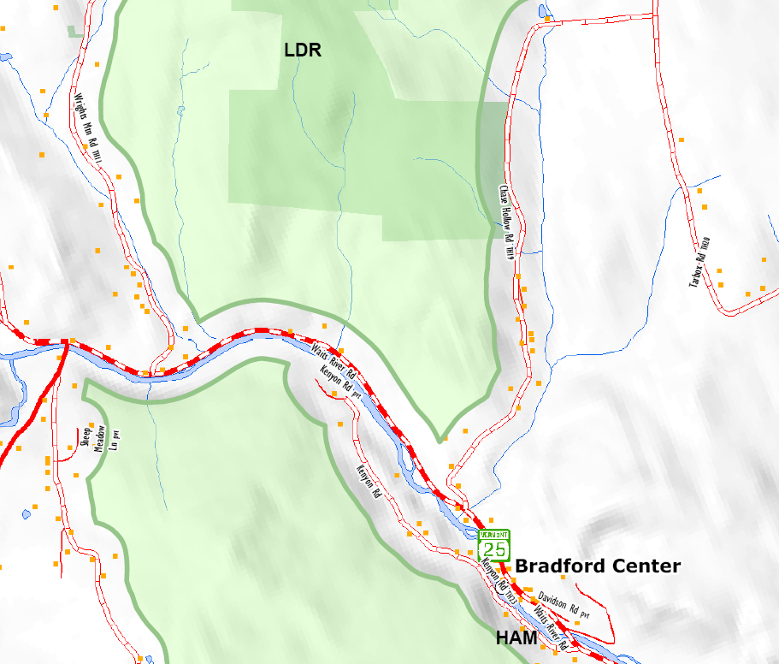
Rural Lands Districts
Rural Districts can put varying emphasis on development.
Notes:
Roads are an economic driver for this. New roads with more houses = more cost to the town to improve the road so you can drive a school bus up it.
Some regions would want to talk about low density zoning and clustered development in subdivision.

Slide 13
Using overlays to protect ecological values
Overlay areas are good to use when the attribute they are protecting may shift with better information, avoiding the possibility of having lands in no district. Examples include:
  Watersheds
  Flood plains
  Wetlands
  Stream buffers

Slide 14
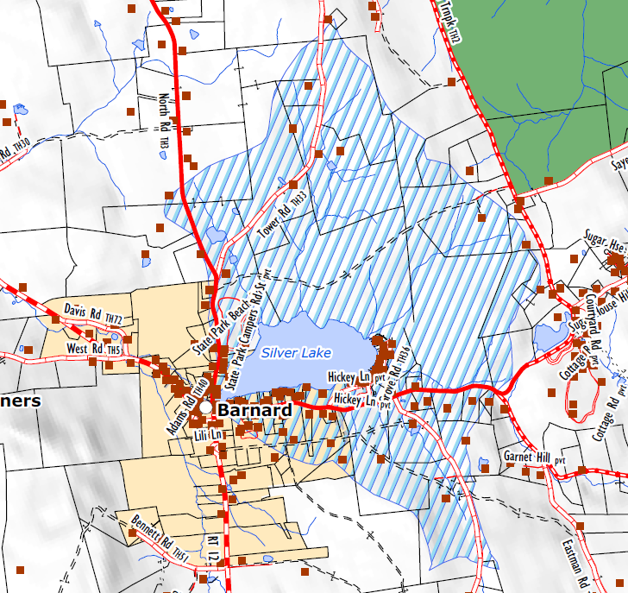
Lake Overlay
Lake overlays may be lands within a certain distance to the lake or all lands mapped as being in the watershed that drains into a lake.

Slide 15
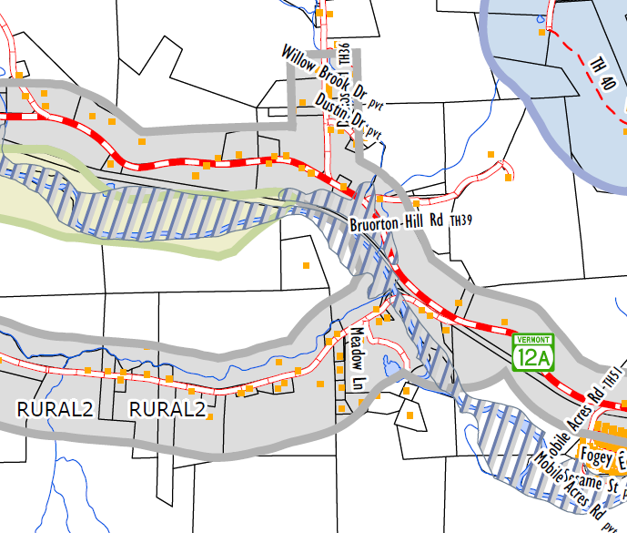
Basic Flood Plain Overlay
Covers lands shown on the latest map from FEMA.
    New building development can be prohibited.
    Restricting development in these areas is not only a matter of public safety, it also helps to keep rivers stable, absorb nutrients from runoff, preserve wildlife travel corridors and conserve floodplain plant species.

Slide 16
Specificity (to scare you!)
Molgano decision Act 250 town plan/zoning tests
start with town plan-> too vague
then zoning-> too vague
Ignore both
JAM Golf LLC decision
regulations in South Burlington struck down due to lack of specificity
Open Space Plan can help JAM proof your bylaw/plan
E-Notes – http://www.nrb.state.vt.us/lup/publications.htm#enote
Notes:
See The Environmental Board’s E-Notes for more information.
JAM Golf decision wants towns to be very specific in bylaw language. Conservation objectives should clear enough that any “reasonable person” reading them will understand what is required in order to meet the standard. Phrases such as “…shall protect important wildlife habitat…” are not enforceable, as they leave unanswered key questions such as what “protect” requires and what constitutes “important.”
Failure to be specific could result in your town being sued.

Slide 17
General Standards
General standards are standards that apply to all uses in all districts. Since they will apply to homes and other things that might not even need a permit, they need to be as straightforward as possible to make administration easy.
Numeric standards are best.
  Example: buildings or structures erected from the effective date of these bylaws shall be setback thirty-five (35) feet from the top of the streambank. Grading or filling within the setback area is prohibited.
Second best are standards that rely on a certification or other permit.
  Example: All dams on streams will require a Stream Alteration Permit from VTDEC or a letter stating that no permit is required.
Notes:
Site plan review for the whole town.
Zoning and subdivision use design standards overall.

Slide 18
General Standards
Allowable, but not as desired, are standards that use the judgment of an average person.
  Example: Areas of grading or soil disturbance will be seeded and maintained so as not to result in erosion.
Standards that are not clearly understandable should be avoided for obvious legal reasons.
  Bad Example: Projects shall not have a harmful effect on wildlife or scenic beauty.
  Better Example: Projects will minimize impacts to “necessary wildlife habitat” for furbearers.
Notes:
One option for presenters is to review some expired bylaws and provide bad examples. Alternatively, you could provide some good examples from current bylaws. The bad example above would be good in a town plan, not a bylaw.

Slide 19
District-Specific Standards
These are essentially a general standard for a district or overlay
  Example in Shoreline Overlay: The cutting of trees in a strip paralleling the shoreline and extending 50 feet inland from all points along the shoreline shall be restricted to the following provision: no more than 50% (fifty percent) of the trees 4 inches and over in diameter may be cut.

Slide 20
Site Plan Standards
These have broad enabling in Vermont law (24 VSA section 4416), but cannot apply to one and two unit dwellings.
Typically used for :
Parking
Traffic
Landscaping
Lighting
Utilization of renewable energy

Slide 21
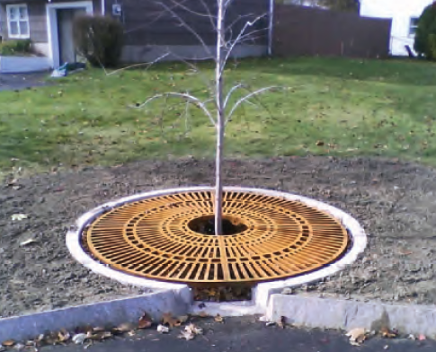
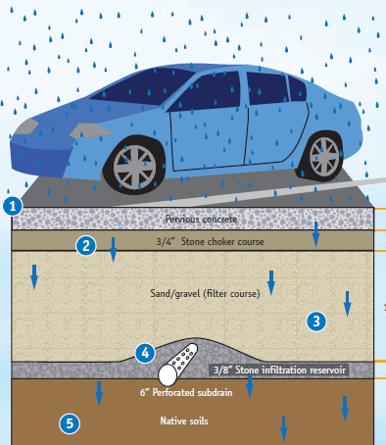
Parking: reducing a project’s impacts on the environment
Runoff can be retained on site to minimize pollution through the use of pervious concrete, porous asphalt, infiltration basins and grass swales.
Notes:
Randolph P&R is an example

Slide 22
Landscaping: putting nature into the built environment
Standards can require the planting of only native species.
Retention of native plants on site can be required.
Reasonable removal of non-native species can be required.
Plant species that provide wildlife forage can be suggested, and possibly required as a mitigation action if needed.

Slide 23
Conditional Use Approval Standards
There are five required conditional use standards for all conditional uses, so that “the proposed conditional use shall not result in an undue adverse effect on any of the following:
  (i) The capacity of existing or planned community facilities.
  (ii) The character of the area affected, as defined by the purpose or purposes of the zoning district within which the project is located, and specifically stated policies and standards of the municipal plan.
  (iii) Traffic on roads and highways in the vicinity.
  (iv) Bylaws and ordinances then in effect.
  (v) Utilization of renewable energy resources.
Notes:
SHALL

Slide 24
Conditional Use Approval Standards
Special conditional use standards can apply throughout town, just in certain districts, or just for certain uses
    Conditional uses might be required to delineate wetlands.
    Houses could be made as conditional uses in Conservation districts and have tighter site performance standards on lighting, site clearing, etc. to minimize impacts.
    Subdivisions themselves can be a conditional use.
Notes:
The NWI maps are poor, so they should be used as indicators of wetlands nearby, not as regulatory tools for showing exactly where they sit on the earth.

Slide 25
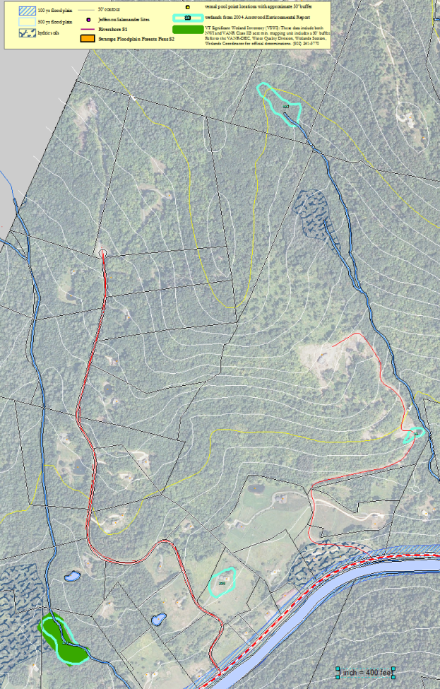
How can ecological values be protected during development review in subdivision bylaws?

Slide 26
What is a Subdivision Bylaw?
Adopted and administered just like zoning.
Can be combined with zoning in a “unified bylaw”
Deals with “subdivisions”, i.e. the creation of new property boundary lines and lots.
Can be scaled so that it only kicks in at certain sizes, number of lots, pace of lots, etc.
Can have differing standards by district.
NOTE: Towns with both zoning and subdivision become a “10 acre town” under Act 250 instead of a “1 acre town”, unless the Selectboard resolves by ordinance to not have this occur.
Notes:
Act 250 regulates subdivisions of 5 lots w/in 5 miles w/in 5 years. Unless a town has both zoning and subdivision, then it changes to 10 lots. Lowers the regulatory burden – perhaps inadvertently.

Slide 27
While zoning bylaws are mostly about the “what”, subdivision is about the “where”.
Through the regulating the placement lot lines; roads, utilities and buildings; and use of clustering and/or density requirements, rural-style subdivisions can still be done, preserving much of the value to the landowner (and maybe even increasing it), and also leaving large parts of the original parcel intact so that they retain their ecological value.

Slide 28
Where to begin?
Subdivision, like zoning, begins in the Town Plan.
The Town Plan should recommend adopting subdivision bylaws if you want to have them.
The Town Plan is where the community can provide background on the ecological value of wildlife and natural systems, and set policies on their protection to form the basis for later regulatory standards.

Slide 29
Subdivision Review
If you are only doing zoning, you are often too late to protect many natural resources. Zoning deals with the cow once it’s out of the barn. In rural areas, regulating subdivisions is a BETTER WAY than regulating standard uses through zoning to ensure:
proper road layout, access and transportation interconnections
stormwater is well-managed
lots are buildable
land is not needlessly fragmented
impacts to natural resources such as prime farmland, wetlands, critical habitat, etc. are reviewed

Slide 30
Subdivision Review
Limiting access limits impacts
    Subdivision review can require a single access or minimization of accesses to keep traffic mobility, but it also helps to limit land fragmentation.

Slide 31
Road Standard Examples
Access Standard Example
Access to any lots within a subdivision shall be limited to a single shared access point, unless public safety is better served by two accesses or topography precludes single access. Any additional subsequent subdivision shall be restricted by permit to the existing access(es) point(s) as approved for the initial subdivision. Access points shall be on existing side roads when feasible.

Slide 32
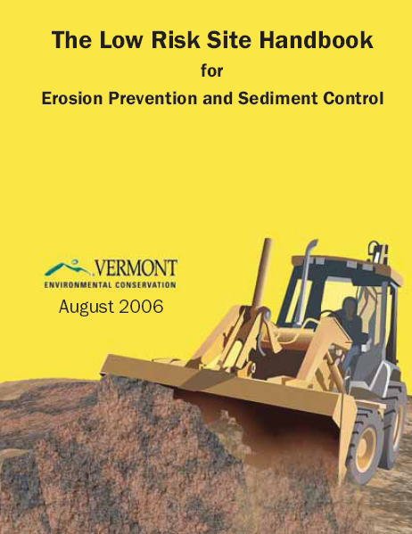
Stormwater Management
Stormwater is often the major source of water pollution in Vermont. Poorly managed stormwater introduces pollutants into streams and causes algal blooms in lakes. Sites disturbing more than an acre of soil or creating more than an acre of impervious surface (including gravel roads) need a state operational permit, but towns can extend regulation to all sites.
Stormwater Standard Example
All subdivisions disturbing the ground or
involving construction shall, at a minimum,
be required to utilize stormwater control
measures contained in the Low Risk Site
Handbook for Erosion Prevention and
Sediment Control.
Notes:
Does your region have a stormwater impaired area in it? If so, presenters may want to know that before the TOEC. These regs may be different in an impaired region.
What about post-development requirements, like LID? Can go above and beyond these minimums.
Could add as a general standard in zoning bylaw.

Slide 33
Subdivision Review
Ensuring lots are created that are buildable will avoid conflicts later on in zoning, helping to avoid requests for variances, or just failure/inability to review impacts.
Three common factors affecting building:
Slopes
Wetlands
Flood Hazard Areas

Slide 34
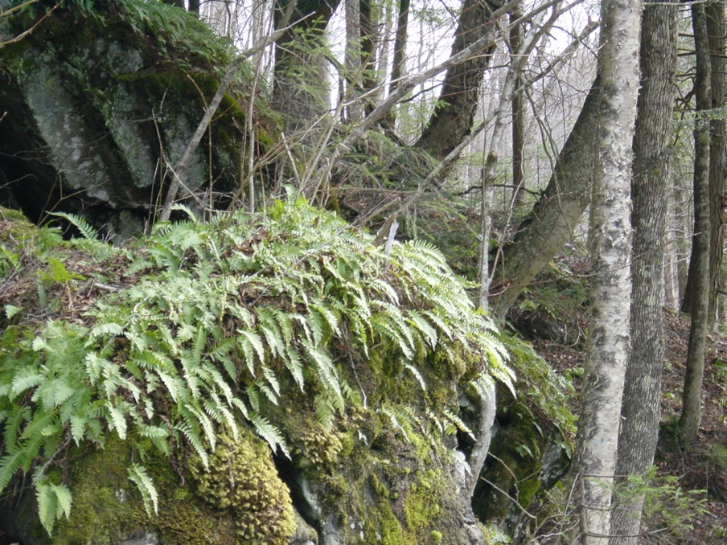
Overall Suitability
Development Suitability Standard Example
Land shall not be subdivided so that any lot consists of land designated as flood hazard areas , wetlands, or characterized by poor drainage, steep slopes, or subject to other hazardous conditions to the point where the lot is not buildable, unless building has been restricted on the lot by easement or other legal restrictions.
Notes:
Add “where reasonable” to prevent creating an unbuildable lot. Also: feasible, possible, practical (in this order).
Can create an unbuildable lot, inadvertently, but by law cannot create an inaccessible lot.

Slide 35
Fragmentation
“. . . when larger parcels are divided and sold or transferred into multiple parcels, often through the process of subdivision, the result can be disjointed land ownership patterns that promote new housing and infrastructure development (roads, septic, utility lines, etc.). When this development occurs, it can fragment the landscape and negatively affect plant and animal species, wildlife habitat (called habitat fragmentation), and water quality.”
From The Final Report of The (Vermont) Roundtable on Parcelization and Forest Fragmentation, May 2007.
Notes:
Edges are good for some species, but not all!

Slide 36


Fragmentation
Subdivisions always fragment land, but lot design can unnecessarily chop up land, limiting its future use for agriculture, forestry or conservation.
Notes:
Give example of putting a road thru the playground, or your front yard. It’s not “just” a road. There’s a better place for it.

Slide 37
Fragmentation Standards
Fragmentation Standard Example #1
Subdivision of forest resource areas shall be permitted only where the Planning Commission finds that the subdivision has been planned to minimize the loss of forestry potential by providing for building densities, lot sizes, and the use of cluster planning designed to economize on the costs of roads, utilities, and land usage.
Fragmentation Standard Example #2
Conservation of Open Space – All major subdivisions in the Rural and Rural Residential Districts will be required to maintain at least 80% of the total acreage in contiguous (but not necessarily single ownership) and undeveloped acreage.
Notes:
Example #2 is from Hartland.
It will take an outside specialist, PE, GIS person, etc. to calculate the 80%.

Slide 38
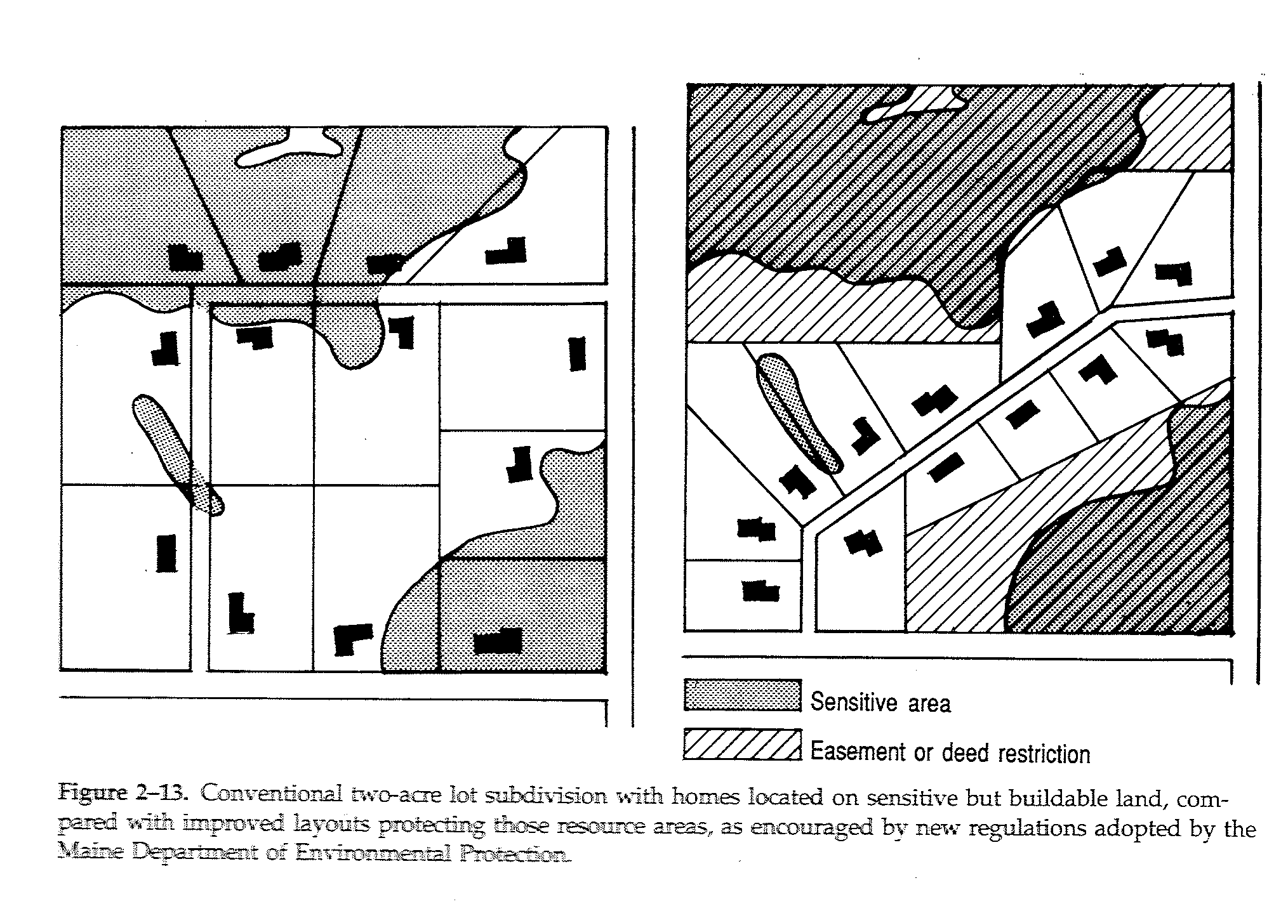
From Randall Arendt’s Rural By Design, page 21.
Lot Lines
Lot line placement can be regulated. In this example the sensitive areas have been protected not only by permit or easement, but also by drawing the lot lines so they are best managed as a whole and protected.
Site restrictions would be the next best way to achieve this.
Notes:
Example on right costs less to build because it’s the same # of houses using less road.
Preserve acreage thru common ownership by association, land trust, or sell to the farmer next door, etc.

Slide 39
Site Restrictions
“Cut lines” and/or ground disturbance boundaries can be established. These should be flagged, especially any larger trees that are to be saved.
Building “envelopes” can be used to approximately site structures. These should be flagged on the ground.

Slide 40
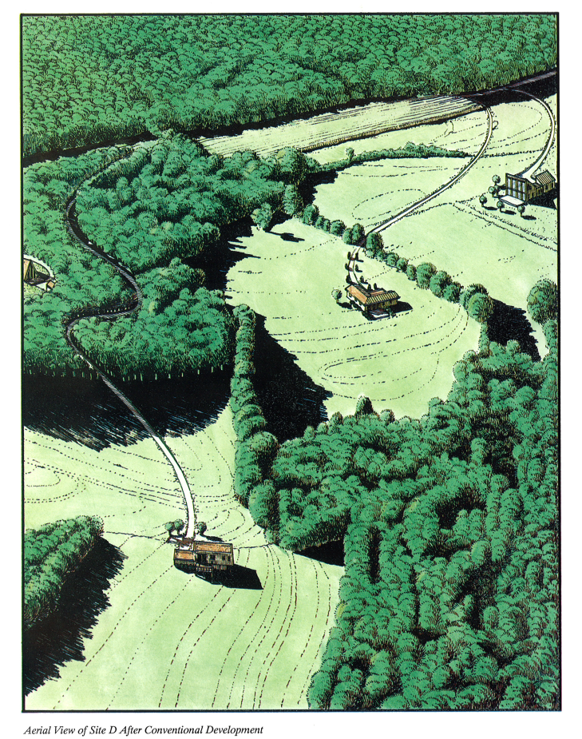
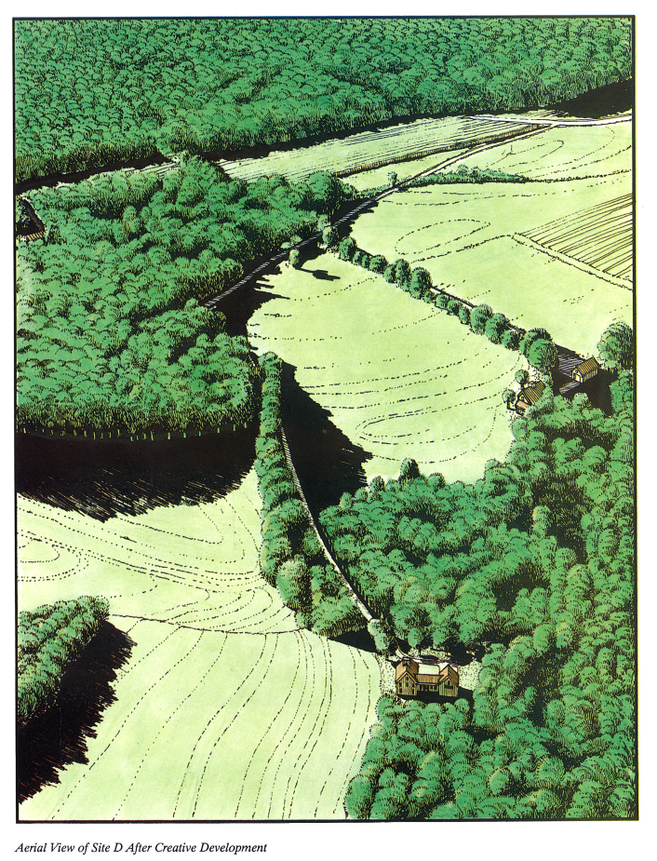
Graphics from Dealing with Change in the Connecticut River Valley: A Design Manual for Conservation and Development, by Prof. Robert Yaro, Randall Arendt, Harry Dodson and Elizabeth Brabec, pgs 52-3.
You can let them go here . . .
or tell them they can’t.

Slide 41
Clustering and Density:
Density is an idea that gives you the SAME number of buildings per original parcel, while not requiring large lots and ensuring the remainder stays undeveloped.
Can lessen development costs and still preserve land value, while meeting conservation objectives.
OR

Slide 42
Clustering and Density
Bonuses can be added to make additional conservation even more attractive.
OR

Slide 43
Resources
Publications
Chittenden County Natural Areas Planning Guide, Chittenden County RPC, September 2009.
Conserving Vermont’s Natural Heritage, Vermont Fish and Wildlife Department, 2004.
Practical Ecology, Dan Perlman & Jeffrey Milder, 2005.
Connecticut River Management Plan, Water Resources Plan, Upper Valley Section of the Connecticut River Joint Commissions, 2009.
Visualizing Density, Julie Campoli and Alex S. MacLean, 2007.
Rural by Design: Maintaining Small Town Character, Randall Arendt, 1994.
Websites
Native Plants - http://www.wildflower.org/collections/collection.php?collection=VT
Stormwater - http://www.unh.edu/erg/cstev/
Bylaws - http://www.vtfishandwildlife.com/cwp_zoning.cfm
Natural Resources Contacts
RIPARIAN BUFFERS Mike Kline, Fluvial Geomorphologist, River Management Program
Vermont DEC, Waterbury, Vermont, (802) 241-3774 mike.kline@state.vt.us
WETLANDS Rebecca Chalmers, Wetlands Ecologist
Vermont DEC, Barre, Vermont, (802) 476-2678 rebecca.chalmers@state.vt.us
WILDLIFE Forrest Hammond, Wildlife Biologist
Vermont Dept. of Fish and Wildlife, Springfield, Vermont, (802) 885-8832 forrest.hammond@state.vt.us
Kim Royar, Wildlife Biologist
Vermont Dept. of Fish & Wildlife, Springfield, Vermont, (802) 885-8831 kim.royar@state.vt.us
NATURAL COMMUNITIES Eric Sorenson, Ecologist, Non-Game & Natural Heritage Program
Vermont Dept. of Fish and Wildlife, Waterbury, Vermont, (802) 241-3714 eric.sorenson@state.vt.us

Slide 44
Questions?
Contact Information
Pete Fellows, GIS Manager, CFM
pfellows@trorc.org
Kevin Geiger, Senior Planner, CFM AICP
kgeiger@trorc.org
802-457-3188

