Slide 1

Essentials of Land Use Planning and Regulation
Introductions
Planning for a Vibrant Sustainable Community
Roles and Responsibilities
Implementing the Plan
Meetings, Hearings and Due Process
Notes:
- Review Topics list
Reiterate that that the training is the basics – there is a lot to learn and it changes so this is a good refresher and way to get new information.
- Introductions:
Small Group – individual intros with name, board, # of years as board member
Large Group – acknowledge new board members, ask about experience levels,

Slide 2
Planning for a vibrant Sustainable community
Section 1

Slide 3

Statutory Basis for Planning and Regulation
Municipal and Regional Planning and Development Act – Chapter 117
1921 – The Vermont Legislature first authorized municipalities to create planning commissions that could draft municipal plans
1931 – The Vermont Legislature first authorized Zoning Regulations.
1968 – Municipal and Regional Planning and Development Act – Chapter 117
    Included purposes of planning and zoning
    Contents of municipal plans
    Adoption process for municipal plans
    Authorized zoning including specific types of review and regulations
1988 – Act 200 substantially updates local and regional planning portions of Chapter 117
2004 – Act 115 incorporates additional significant updates to the zoning portions of Chapter 117
Notes:
Vermont has been planning since the 20s
Chapter 117 was established in 1968 which defined planning more as we know it today.
Major overhaul in 1988 of Chapter 117 focused on planning (list of state planning goals to be considered and the required “elements” )
Changes occurred again in 2004 focused on zoning (such as process, affordable housing); communities had until 2011 to address the new requirements in their bylaws

Slide 4
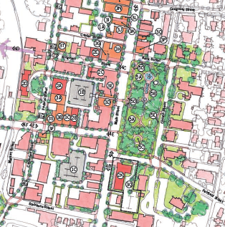
What is a Municipal Plan? Why have one?
What: A guide for accomplishing community aspirations and intentions through public investments, land use regulations and actions the town can take to achieve its vision.
Why:
Inclusive process develops community-wide vision
Empowers communities to respond to change in ways that reflect their own goals, needs, priorities and values.
Allows communities to designate areas to maintain as is, evolve over time or to transform more quickly into a better place.
Notes:
WHAT:
WHY… A municipal plan considers how different areas of town can be planned as a single unit and meet the needs of the community and develop a community-wide vision.
- Development can be planned by anyone…individuals, businesses, the town, or a combination of all of these, but no one just starts nailing boards together without a plan. So it is important to consider all together, how you want your community to grow to guide future development.

Slide 5
With a current plan you can…
Adopt Zoning, Subdivision and Flood Hazard Regulations
Affect Act 250 projects as applications must conform to your Town Plan
Affect state and local access permits
Have your Town’s wishes considered in energy project reviews (Section 248 Certificate of Public Good Applications)
Make more competitive grant applications
Notes:
Benefits of adopting a plan – once you have a plan you can…
- Be eligible for VT Community Development Programs funds (doesn’t require confirmed planning process like MPGs)
-Can adopt flood hazard regulations by ordinance too. (ex Isle la Motte)

Slide 6
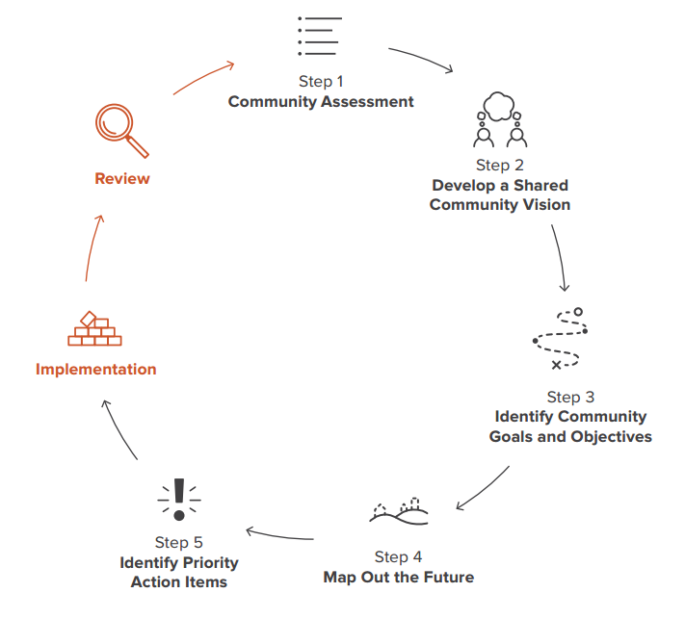
The Planning Process
Notes:
Reminder that a Plan is a living document, that is constantly cycling through the process as information, community circumstances and goals change.
Once adopted it’s a good practice to conduct an annual review of the implementation strategies and to determine what steps to focus on in the coming year. Review of the plan is also important when it comes time to update the plan.

Slide 7
Vermont Planning Process Goals
Planning Process (§4302, §4381-§4387)
  Coordinated comprehensive process to guide decision
  Citizen participation at all levels
  Consider use of resources and consequences of growth and development locally and beyond
  Work with neighboring municipalities and region to implement plans
The process is often more important than the product!
Notes:
In order to work towards a common vision – need input from the community and coordination between other boards, commissions, and neighboring towns.

Slide 8
“When it comes to planning, if you’re not doing it with people – they think you are doing it to them.”
Roger Millar, AICP
National Complete Streets Coalition
Notes:
People generally resist change unless they helped initiate it.

Slide 9




Types of Citizen Participation
INFORM
Commit to keeping citizens informed about planning. Help the public understand problems and solutions.
  ✶ Fact Sheets  Newsletters  Websites
CONSULT
Provide opportunities for input on existing ideas – listen, acknowledge concerns and answer questions.
  ✶ Surveys  Public Meetings
INVOLVE
Provide opportunities for dialogue and interaction. Obtain advice from the public and generate new ideas.
  ✶ Workshops  Focus Groups
COLLABORATE
Partner with the public in decision-making, including the development of alternatives and identification of the preferred solution.
  Citizen Advisory Committees
  Participatory Decision Making (Charrettes)
INFORM
Commit to keeping citizens informed about planning. Help the public understand problems and solutions.
  ✶ Fact Sheets  Newsletters  Websites
CONSULT
Provide opportunities for input on existing ideas – listen, acknowledge concerns and answer questions.
  ✶ Surveys  Public Meetings
INVOLVE
Provide opportunities for dialogue and interaction. Obtain advice from the public and generate new ideas.
  ✶ Workshops  Focus Groups
COLLABORATE
Partner with the public in decision-making, including the development of alternatives and identification of the preferred solution.
  Citizen Advisory Committees
  Participatory Decision Making (Charrettes)
Notes:
An important piece of your planning should be Citizen participation
Use a combination of outreach types in order to reach all segments of the town such as: web, direct mailing, surveys, FPF, charrettes, etc
To know which type of involvement you should conduct, consider the type of information you want to get…
→ Understand your GOAL to know the OPTIONS
Are you informing? Front Porch Forum
Looking for input on existing ideas? Surveys
Wanting to generate new ideas? Focus Group
Involvement to develop alternatives? Charrette
It is important to try and match the type of outreach to the for your need to get the information you want.
We can assist with selecting and conducting outreach for your planning efforts

Slide 10
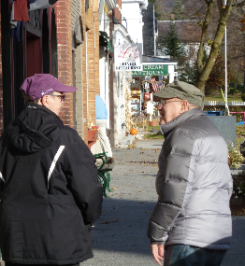
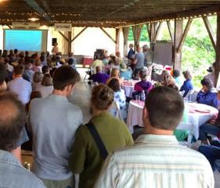
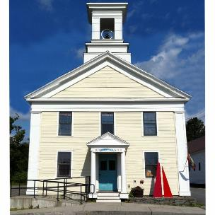
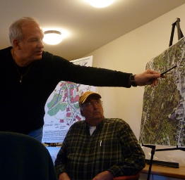

Engaging People in Planning
Talk to people
Food, fun and celebration
Meet people where they are
A culture of communication
Notes:
Talk to people – In small towns especially the best approach is talking directly with people who will be affected by a planning initiative. This helps alleviate fears and communicates respect. Some approaches:
Each planning commissioner commits to talking with 10 people
All the town boards, commissions and staff have opportunities for input and understand the issues
The people in town who have the most connections hear directly from you so they spread accurate information
Meet people where they are – go to places where people already gather to engage with them there rather than expecting them to come to your meeting. Some possible locations:
Senior centers
Schools
Grocery stores and farmers markets
Same goes for the language you use – explain your planning initiatives in a way people can relate.
Food, fun and celebration – Make gatherings a celebration of the community. Food and fun attract people. Engage young people to help organize an event like:
Public forum or open house with pizza or pot luck snacks
Photography or art contests on planning-related topics
A culture of communication – Planning works best where town government values communication between staff, boards and commissions and the general public. Ways to improve communication:
Always use front porch forum and other web or email tools to routinely inform people about town business
Support places in town where people can gather for all kinds of purposes, such as making the town hall useable and welcoming
Support places and events where people can run into each other informally like cafes and parks and community fairs and parades
Hold walk and talk sessions allowing side by side conversation about a specific place and problem
Recruit a wide range of people for boards and commissions and hold occasional all-board events
Create short term advisory committees for special projects to bring in people who can’t commit to long term appointments

Slide 11
VERMONT’s PLANNING
GOALS
(24 VSA §4302, local plans may be compatible, but shall be for regional approval)
Vibrant Sustainable Community
Compact Centers
Strong Diverse
Economy
Education and Vocational Training
Available Child Care
Efficient Public Facilities and Services
Recreational Opportunities
Quality Housing
Available
Efficient Energy Use and Renewable Resources
Agricultural and Forest Industries
Flood Resiliency
Use Natural Resources Efficiently
Preserve Natural Resources
Air, Water and Wildlife Quality
Safe Convenient
Transportation
Notes:
Even the smallest town is a complex system, so to plan for the future, you dealing with many interlocking issues.
State law lists a wide range of goals for town plans to address.
Town Plans MAY be consistent with planning goals, SHALL be consistent if towns want to seek regional approval.
Consistent means that it should not conflict with the goals and requires substantial progress towards attainment.
REFERENCE:
As used in this chapter, "consistent with the goals" requires substantial progress toward attainment of the goals established in this section, unless the planning body determines that a particular goal is not relevant or attainable.

Slide 12
It’s Your Municipal Plan
(But there are requirements [§4382])
Objectives, Policies and Programs
Land Use (Map and Statement), including any state designation
Transportation (Map and Statement)
Utilities and Facilities (Map and Statement)
Education (Map and Statement)
Energy (Option for Enhanced Energy Plan)
Economic Development
Housing
Flood Resilience
Policies on Preserving Rare Natural Areas
Compatibility with Adjacent Municipalities and Region
Implementation Program
Notes:
State statute also instructs towns to include elements in a plan that correspond to the statewide planning goals.
Town Plans SHALL include these elements.
There are requirements but you can still make the plan your own…with how you present the plan. (Creativity)
-------
Note State Designations need to be addressed and mapped!

Slide 13
The Town Plan is the only statutory comprehensive document created publicly by the town to lay out a plan for tomorrow, not yesterday or today.
The more specific, the more utility in reaching desired conditions
The more specific, the more difficult in reaching community agreement
Notes:
With all the statutory requirements, it’s easy to get caught up in creating a big book describing the existing conditions in your town but go beyond that and focus on creating a shared vision. What does your town want to be in the future?

Slide 14
Municipal Plan Adoption
Plans expire every 8 years
  Revise or rewrite the plan before expiration – at a minimum, make necessary edits to data and implementation program
Adoption process can take several months
  Planning Commission hearing with notice to adjacent communities
  Selectboard hearing (1 in rural municipalities and 2 in urban)
  Decision on adoption shall be made by Legislative Body, unless the Legislative Body or voters have elected to decide by Australian Ballot
  Plans go into effect upon adoption
Notes:
8-year expiration for any plans adopted after July 2015. Any adopted before have a 5-year expiration.
Rural Municipality: 2,500 persons or less
Urban Municipality: More than 2,500 persons
REFERENCE:
Urban Municipalities (list for your region):
Enosburgh (w Village), Fairfax, Georgia, Highgate, St. Albans Town, St. Albans City, Swanton
Adoption by legislative body – the default in statue is that the legis. Body can choose the method. Still need hearing process of PC→SB but then adoption would be done by the SB or voters.

Slide 15
Regional Plan Approval & Confirmation
Municipalities may request RPC approval of the municipal plan.
RPCs will confirm the municipal planning process if:
  If the municipal plan has been approved by RPC
  The municipality is engaged in a process to implement the plan
  Is maintaining efforts to provide funds for planning
A confirmed Planning Process allows municipalities to:
  Apply for state designation of downtowns, village centers, new town centers, neighborhood development areas and growth centers.
  Apply for Municipal Planning Grants
  Levy impact fees
  Have plan considered by state agencies in their planning
Notes:
Towns and cities can access additional benefits if the town plan has been approved by the RPC and the planning process has been confirmed by the RPC.
A municipal plan is approved by the RPC if it is:
Consistent with the statewide planning goals
Compatible with the regional plan and plans of other municipalities in the region
Contains the required town plan elements.
RPCs meet with member municipalities once every four years to understand the towns’ needs and determine if any assistance is needed

Slide 16
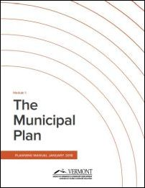
Vermont Planning Manual – www.vpic.info
Notes:
New guidance for working on your Municipal Plan. An updated version of the Planning Manual, Module 1 was just released in January. Available online only at this point.

Slide 17
Roles and Responsibilities
Section 2

Slide 18
Local Roles and Responsibilities
Roles and responsibilities are delineated both by statute and by function:
Legislative
Judicial
Administrative
Notes:
These can be related to the 3 arms of the US government:
Legislative – Congress – writes the regulations
Judicial – Supreme Court – interpreting the regulations
Administrative – Executive Branch – Administers and interprets strictly in a non-discretionary way.

Slide 19
Local Roles and Responsibilities
Legislative Body
Administrative
Legislative
Quasi-Judicial
EITHER
Planning Commission
Development Review Board
Zoning Board of Adjustment and Planning Commission
Zoning Administrator
OR
Notes:
What does this look like locally?
The Legislative Body can be one of the following: Selectboard, City Council, Village Trustees.
Legislative branch – In municipalities, Planning Commissions and Selectboards have a legislative role when they write and adopt plans and regulations..
Quasi-Judicial – In Municipalities, DRBs and ZBAs have a quasi-judicial role, using their discretion to interpret the land use regulations.
Administrative – For local land use regulations, the zoning administrator (also known as the administrative officer) interprets the regulations in non-discretionary way

Slide 20
Legislative Function
Planning Commission
  Prepares the Municipal Plan
  Prepares Zoning/Development Regulations
  Can prepare or edit Capital Budget and Program
  Prepares other studies
Legislative Body
  Reviews and may edit Municipal Plan and either adopts or sends to voters
  Reviews and may edit Zoning Bylaws/Development Regulations and either adopts or sends to voters
  Prepares or edits and adopts Capital Budget and Program
Notes:
Day to Day tasks…

Slide 21
Quasi-Judicial Function
Development Review Board
  Site plans
  Subdivisions
  Conditional uses
  Lots without frontage
  Variances
  Appeals of ZA decisions
Planning Commission
  Site plans
  Subdivisions
  Lots without frontage
  Zoning Board of Adjustment
  Conditional Uses
  Variances
  Appeals of ZA decisions
OR
Notes:
Reasons to have a DRB model:
Simplifies the roles of the boards and the process for the applicants
Allows the PC to focus on planning functions
Membership can overlap between the PC and DRB (Legislative and Quasi-Judicial boards)
REFERENCE
Statute size of boards: PC/ZBA 3-9; DRB 5-9

Slide 22
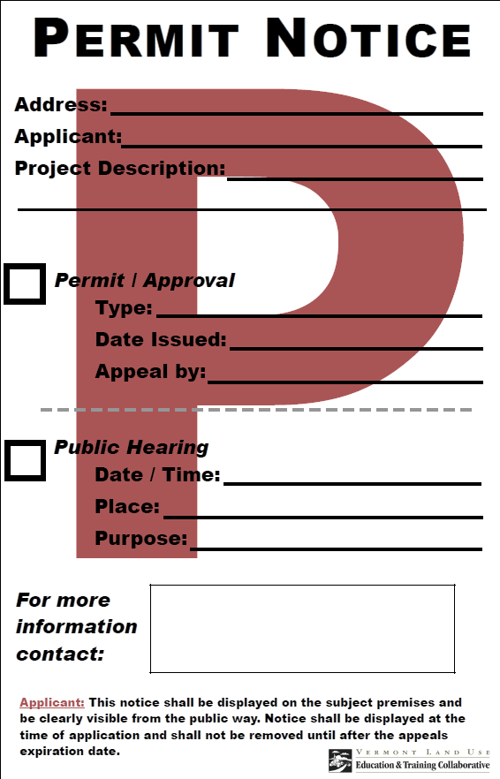
Administrative Function
Zoning Administrator
  Issues zoning permits
  Coordinates across permitting
  Conducts Enforcement
  Assists applicants
  May staff DRB, PC, or ZBA
  May also handle review functions
  for projects without significant
  impacts per 24 VSA 4464(c)
Notes:
Zoning administrators issue permits that the zoning regulations have determined can be approved administratively as long as the proposed development or activity is in conformance with the required density, dimensions and uses prescribed in the regulations.
ZA’s enforcing the requirements of permits or making sure building does not commence without Depending on the town, ZA’s will have other functions and duties.

Slide 23
What’s the difference?
Regulation
Bylaw
Ordinance
Notes:
Confused by terms?
The words – Bylaw, Ordinance and Regulation – pretty much mean the same thing.
In Vermont statutes governing land use planning the word Bylaw (an old English word meaning town law) is used for zoning, subdivision and other land use regulations adopted in conformance with a municipal plan.
The word Ordinance is used to refer to regulations adopted directly by Selectboard and other municipal legislative bodies like public works standards and noise ordinances.
The word Regulation is used as an umbrella term generally referring to all types of governmental rules.
Some differences between Bylaws and Ordinances: Bylaws grandfather non-conformities. Ordinances do not grandfather and are effective immediately. Bylaws and ordinances also have separate adoption processes outlined in statutes.

Slide 24
Implementing the Municipal Plan
Section 3
Notes:
Putting the plan into action

Slide 25
Implementing the Plan
Municipal Plan
Regulatory Implementation
Zoning and Subdivision Bylaws
Flood Hazard Bylaws
Local Ordinances
Non-Regulatory Implementation
Improving public facilities
Informing/engaging citizens
Supplemental plans
Notes:
Intent of making a plan is to realize the goals and aspirations it contains. Many different ways to go about doing this. Can be categorized into regulatory (rule based) and non-regulatory (non-rule based).
As of 2016, municipalities now must document that it is actively engaged in a process to implement its plan as a part of the regional confirmation process. RPCs can help you complete this documentation as part of the routine consultations.

Slide 26
Why Have Local Land Use Regulations?
Implement the vision and goals in your municipal plan, such as:
Promote compact, walkable development
Protect important natural resources
Minimize fragmentation of farmland
Incentivize affordable housing
Encourage efficient use of infrastructure
Ensure compatibility with historic character
Establish safe vehicular and pedestrian circulation
Make communities more flood resilient
Notes:
Exploring the ins and outs of the regulatory side – why might a community consider land use regulation as a way to implement a town plan?
It can be an effective way at furthering a plans vision and goals – for example –
A goal for promoting compact development can be furthered by implementing regulations that ensure buildings, driveways and streets support the desired pattern of development.
Natural resource protection and farmland fragmentation can be furthered by minimizing new development including limiting the layout and length of new roads and driveways and supporting the kind of uses that are compatible with maintaining farms, forests and large parcels of land.
Its also worth noting that in Vermont, more projects are subject to Act 250 rview if the community does not have zoning and subdivision regulations - as it determines whether commercial development triggers Act 250 review on 1 acre vs 10 acres, and whether a subdivision triggers Act 250 with 6 lots vs 10 lots.

Slide 27
Limits of Local Regulation
  Land use regulations tell people what they can and cannot do with their land, but they cannot deprive landowners of all reasonable use of their property (5th and 14th Amendments)
  Land use regulations can only regulate what is enabled in Vermont Statute (Dillon's Rule)
  Vermont Limitations and Prohibited Effects (§4412 and §4413)
  Democracy takes place in the formation of the regulations, NOT in their administration
Notes:
First, land use regulations can tell people what they can and cannot do with their land, but they cannot deprive landowners of all reasonable use of their property without just compensation – which would be considered a government taking.
The 5th and 14th constitutional amendments limit a municipality's authority in this way, while subsequent court cases have clarified what all reasonable use of property means.
Second, Vermont is considered a Dillon’s Rule State as opposed to a Home Rule State, which means that municipalities can only regulate what is specifically enabled by Vermont Statute.
Third, Vermont Statute places specific limitations on local regulation, such as:
-Treat housing types equal and avoid discrimination against affordable housing
-Protect home occupations and home daycares
-Ensure continuation of "nonconformities“; small lots may be developed
-Lots without frontage may be developed with adequate access
-Regulation of public facilities shall not interfere with intended functional use
-No local regulation of accepted agricultural and silvicultural practices and applications requiring a Certificate of Public Good
------------------------------------------------------------------------------------------------------------------------------------
Mahon v. Pennsylvannia, Penn Central v. New York. Regulation of land was not a taking. Rather, it was simply an exercise of the government’s police power to protect the public health, safety, welfare, and morals. But a recognition of the invalidity of a government regulation that goes too far when it takes private property for public use under the Fifth Amendment. Penn Station to high rise – denial not a taking.

Slide 28
Players and processes potentially involved in local regulation
Zoning Administrator Receives Application
Administrative Applications
Zoning Administrator Conducts Review
Zoning Administrator Issues or Denies Permit
Quasi-Judicial Applications
DRB, ZBA or PC Conducts Review
Quasi Judicial Panel Issues Decision
Opportunity for Appeal
Opportunity for Appeal
Notes:
This slide shows the flow of a local zoning application and who is involved in review.
Starts with ZA. Then applications either follow an administrative review track (where only ZA is involved in making decision) or a quasi-judicial review track (where one or more local boards is involved).
The recommended practice for the quasi-judicial track is that the ZA issues a permit when all board approvals have been obtained.

Slide 29
Local Regulation: Types of Review
Land Development:
Division of a parcel into 2 or more parcels
Construction, reconstruction, conversion, structural alteration, relocation, or enlargement of any building or other structure
Or of any mining, excavation, or landfill
Any change in the use of any building or other structure, or land, or extension of use of land
Type of Review | Function of Review
Zoning
Permitted Use | Established by right
Conditional Use | Can be established if found to be compatible
Site Plan Review | Ensures good site design, use is appropriate
Variances | Stringent statutory exception process
Waivers | Flexible local dimensional standards
Planned Unit Developments | Allows for flexible design
Subdivision | Controls the pattern of future development
Notes:
Vermont statute enables many different types of land use review and standards to be incorporated into local regulations.
Definition of land development.
The most commonly uses reviews are shown in this table.
Permitted uses – permitted administratively, require a permit with limited review.
Conditional Use – Considers external impacts of use and compatibility surrounding land uses.
Site Plan – Considers internal impacts of use by looking at the design of the specific parcel.
Variances – allows for relaxation of dimensional standards for structures in very specific, uncontrollable circumstances
Waivers – allows for relaxation of specifically defined rules so long as there is a clearly defined process and standards for how the waiver will be applied
PUD – allows for flexible development plan for specific project – some rules may be modified as a carrot for implementing good site design. Most common form of this is also known as conservation subdivision. If lots and units are clustered on smaller lots that normally would be allowed, the developer may be allowed more units as long as the remaining land is restricted from further development.
____________________________________________________________________________________________________________________
Conditional Use:
(i) The capacity of existing or planned community facilities.
(ii) The character of the area affected, as defined by the purpose or purposes of the zoning district within which the project is located, and specifically stated policies and standards of the municipal plan.
(iii) Traffic on roads and highways in the vicinity.
(iv) Bylaws and ordinances then in effect.
(v) Utilization of renewable energy resources.
Variance:
(1) There are unique physical circumstances or conditions, including irregularity, narrowness, or shallowness of lot size or shape, or exceptional topographical or other physical conditions peculiar to the particular property, and that unnecessary hardship is due to these conditions, and not the circumstances or conditions generally created by the provisions of the bylaw in the neighborhood or district in which the property is located.
(2) Because of these physical circumstances or conditions, there is no possibility that the property can be developed in strict conformity with the provisions of the bylaw, and that the authorization of a variance is therefore necessary to enable the reasonable use of the property.
(3) Unnecessary hardship has not been created by the appellant.
(4) The variance, if authorized, will not alter the essential character of the neighborhood or district in which the property is located, substantially or permanently impair the appropriate use or development of adjacent property, reduce access to renewable energy resources, or be detrimental to the public welfare.
(5) The variance, if authorized, will represent the minimum variance that will afford relief and will represent the least deviation possible from the bylaw and from the plan.

Slide 30
Non-Regulatory Implementation
Complements regulatory implementation
Chapter 117 authorizes:
  Capital Budget and Program
  Tax Stabilization Contracts
  Purchase/Acceptance of Development Rights
  Supporting Plans/Special Studies
  Advisory Commissions
  Conservation Projects
  Other projects and studies (whatever your plan recommends)
Notes:
And there are also non-regulatory town plan implementation options that can complement regulatory implementation or become the focus of plan implementation. There are many options enabled in Vermont statute including…
Shaping current and future town spending to make sure the goals of the plan are achieved – this obviously requires close coordination with the Selectboard (or Trustees/City Council).
Creating favorable tax provisions to create incentives for certain land uses
Purchasing land for conservation or for public facilities
Studying issues identified in the plan in greater depth, such as preparing a detailed plan for a village or evaluating the feasibility of public wastewater treatment.
Creating a conservation commission, housing commission or other permanent or temporary advisory committees to help address issues of concern to the community

Slide 31
Capital Budget and Program
Title 24 § 4430
“(a) A capital budget shall list and describe the capital projects to be undertaken during the coming fiscal year, the estimated cost of those projects, and the proposed method of financing. A capital program is a plan of capital projects proposed to be undertaken during each of the following five years, the estimated cost of those projects, and the proposed method of financing.”
We suggest going out to ten years to help smooth costs.

Slide 32
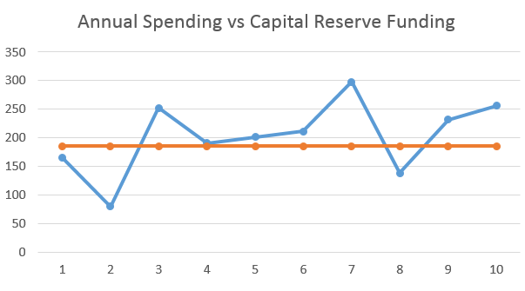
Capital Budgets and Programs
smooth out annual costs
avoid large tax hikes
ensure that needed outlays are met
creates well justified funding requests

Slide 33
Meetings, Hearings and Due Process
Section 4
Notes:
This section focuses on due process –which means simply that all proceedings are conducting fairly for everyone.
Due process is guaranteed by the Fifth Amendment to the U.S. Constitution, which states "No person shall…be deprived of life, liberty, or property, without due process of law," and is applied to all states by the 14th Amendment.
Ensuring due process involves: NOhMoMeCi
Notice
Opportunity to be heard
Maintenance of Order
Management of Evidence
Conflicts of Interest

Slide 34
Meetings vs. Hearings
Meetings
Discuss business or take action
Legislative Hearings
Receive public comment on a course of action (e.g. a plan or bylaw update)
Quasi-judicial Hearings
Hear from parties seeking board approval
Any board
All Public Bodies
Generally legislative
The Planning Commission
Selectboard
Boards that review proposed development
What happens…
Who does it…
Notes:
There are many different types of meetings and hearings that local boards will engage in.
We have regular meetings: review slide. Important to note that a meeting is considered to be taking place when a majority of board members convene to discuss business. Need to be careful a events and gatherings not to discuss board business with other board members, especially if there is a quorum present.
Then there are legislative and quasi-judicial hearings. Review slide.
Board meetings and hearings are run under parliamentary procedure as outlined in Roberts Rules of Order
In a basic sense, this generally involves:
Contribute to discussion on agenda items;
Make motions for action;
Second motions made by other members; and
Vote on motions.

Slide 35
Vermont’s Open Meeting Law
(1 V.S.A. §§310-314)
Post advance notice
Make the agenda available before the meeting
  At the municipal office
  2 other designated places
  A Web site, if your town has one
Let the public participate
Make the minutes available within five days
Address complaints of violations
www.vlct.org/vermont-local-government/vermont-open-meeting-law/
Notes:
The Vermont Open Meeting law includes many due process protections. (Review bullets.)
Exemptions
There are exemptions to the open meeting law, in narrowly defined circumstances including:
- certain electronic communication so long as it does not involve business (it can involve coordination of the agenda and distribution of materials)
- Executive session – for making confidential decisions about certain topics such as personnel, litigation and contracts. Mostly for infrequent use by selectboards
- Deliberative session – for quasi-judicial boards to deliberate on the evidence presented in public hearing.
Remote Meetings
Recent changes to the law, also clarified that meetings can be held remotely where one or all board members are tele or video conferencing in so long as there is a physical location advertised in the agenda with someone present (staff is ok) and that all votes are made by roll call.

Slide 36
Public Notice
Meetings
At least 48 hours*
Legislative Hearings
For plans and bylaw amendments
Quasi-Judicial Hearings
For development review
7/15 days notice**
At town and 2 other places
For regular meetings: 1 VSA §§310-314
15 days
Newspaper of record
Certified Mailings
Newspaper of record
3 or more public places
Mailed to applicants and adjoiners
Posting within view of nearest public ROW
Notes:
There are specific timelines for advance notice depending on the type of meeting or hearing you are holding.
Regular Meetings…
Also note special and emergency meetings:
Special Meetings – 24 hours notice for special meetings, alert media
Emergency Meetings – some notice as soon as possible before meeting. Just posting is fine.
Legislative Hearings… for Plans and Bylaws
Number of hearings – always at least 1 PC hearing, for town plans town over 2500 in population require 2 LB hearings.
A report is also required to accompany certified mailings which documents changes and compatibility with town plan or local regulations.
Quasi-Judicial Hearings
Makes sense to have 15 days notice for site plan review too.

Slide 37

Conflicts of Interest
Financial interest
(direct or indirect)
Personal interest (direct or indirect)
Known bias or prejudice
Ex parte communication
It takes years to build trust with the public, but just one misstep to destroy it.
Notes:
Conflicts of interest can impact the fairness of a proceeding – it is important for board members to understand what constitute a conflict of interest.
Several different types.
Also - Ex parte communication: direct or indirect communication between a member of the DRB and anyone else outside a public hearing on matters involving the application. e.g. DRB members should not discuss a pending case with anyone at the supermarket. If you do it inadvertantely, disclose the interaction at the public hearing.
All communication and discussion regarding an application needs to happen at a public proceeding to protect due process. Everyone involved should be aware of the same information and discussion involving a case.
Note the distinct difference between planning and regulatory functions in regards to communications:
members of a quasi-judicial board must restrict public communications to formal meetings and hearings
planning commissioners must endeavor to create strong lines of communications with the public on all planning initiatives beyond the confines of commission meetings and hearings.

Slide 38
Managing Conflicts of Interest
Adopt Rules of Procedure and Ethics – know them and follow them!
Ex parte communication is very difficult to avoid, so ALWAYS disclose
Recuse oneself when necessary
Use alternates
Notes:
Important to know and understand that conflicts of interest and ex parte communication happen. Board members need to recognize them and have a process established for managing them! Rules of Procedure should memorialize this process.
Tips on how to manage them when they happen….

Slide 39
Flow of Quasi-Judicial Public Hearing
Chair opens hearing
The applicant presents the proposal/request.
Board members ask questions in relation to conformance with specific provisions in land use regulations.
Comment from interested parties/public
Chair closes public hearing and may open deliberations (public or private) or set a date to do that.
Board decides on application and issues a written decision.
Notes:
This slide shows the typical flow of a quasi-judicial hearing.
Rules are stricter for quasi-judicial hearings because board is deciding how to apply the law and needs to protect due process.
Review slide. (Discuss deliberations in detail later)
RECOMMEND that hearings be continued if there is insufficient evidence and decisions not be made the same night.
Hearings continue until board is ready to make a decision.
Deliberations technically start when the hearing is closed. Once a hearing is closed, no new information is introduced.

Slide 40
Opening a Quasi-Judicial Hearing
Review order of events
Remind of the importance of order
Make copies of the rules of procedure and ethics policies available.
Review definition of interested persons,remind all that participation is necessary to retain appeal rights, and ensure documentation of participants. Administer oath.
Request disclosure of conflicts of interests or ex parte communications
Notes:
To set the stage for a fair and orderly proceeding, here is a best practice for opening a QJ hearing…review slide…
Note that EVERY municipality has rules of procedure and ethics policy. Helps to make everyone aware of how proceeding will be run and show that the process is orderly and official. Find yours if you don’t have it!!!
Only briefly define ex parte com - both conflicts of interest and ex parte com will be dealt with later.

Slide 41
Role of the Board Chair
A Chair administers the agenda, keeps board members focused on the issue at hand, and ensures the Board finishes on time.
A Good Chair Should:
  State the Question
  Ask For Discussion (without giving own opinion)
  Ensure ALL aspects are covered that are needed to make findings, continuing hearing if needed
  Bring The Board To Resolution to Close Hearing
  Explain next steps
Notes:
A good chair is vital for smooth, efficient and productive meetings and hearings.
Review first bullet. One of the most important jobs of a chair is to keep the board on track to prevent never-ending debates.
Another important job of the chair is to help turn discussion into action. Review second bullet.
Stating and restating the question and then asking for discussion can move discussions along. Recapping discussion points is also helpful.
To coax a motion - The chair may summarize the discussion that points to a specific action, and then ask for a motion on that action.
This helps bring closure to issues that could be discussed all night, even though the board is ready to make a decision.
A good chair is not necessarily the member who has been on the board the longest or the member who is most outspoken. A good chair needs to be able to sit back and listen and not always contribute their own opinion.

Slide 42

Board Member Role at Quasi-Judicial Hearing
In order to determine a project’s conformance with your regulations and protect due process:
  Listen to testimony and evidence;
  Ask questions so that you can base decision on evidence presented;
  Refer to your regulations;
  Avoid conflicts of interest;
  Must not prejudge a matter or publicly express opinions on a pending case.
Notes:
Board members also have an important role in contributing to a fair and orderly proceeding.
Board members should be concerned with applying their zoning regulations and protecting due process.
Review slide.

Slide 43

Deliberative Session
Exempt from Open Meeting Law
No requirement for notice or minutes
Public or private
No new evidence is allowed
Don’t have to reveal how board members voted
45 days to issue a decision or deemed approved
Notes:
Once a hearing is closed, the rest of the work in making a decision is completed in deliberative session.
Review slide.
Expand on pubic vs. private deliberations.
Vote does not make a decision – decision is issued as a written decision after close of public hearing. Vote does not need to be revealed, but decision should show a concurrence of majority.
Do not issue decision the same night, take the time given to you for thoughtful deliberation before issuing a decision.
Does your DRB or ZBA/PC do public or private deliberations?

Slide 44
Regulatory Decisions
Decisions must:
Be in writing and contain:
  Findings of fact on which each decision is based, and
  Conclusions of law on how the bylaw applies
Be based on review standards in bylaw
Minutes may suffice (but this is a bad idea)
Timeline:
The quasi-judicial panel must issue written decision within 45 days of close of final public hearing. DOES NOT NEED TO BE THE SAME NIGHT OF HEARING!
Who is responsible for preparing decisions?
Notes:
All reviews conducted by a quasi-judicial board must result in a written decision that contains: FF and CL.
- Determining findings of fact and conclusions of law are the board’s responsibility, not interested parties or anyone else at the hearing.-
- While minutes may pass as a written decision if they contain the required elements, they are only appropriate for when decisions are issued in public deliberations.
Review timeline…Reiterate – board has 45 days! No need to make decision that night. Talk more about not making decision on same night later.
Decisions should memorialize a concurrence of majority in making the decision – so it should indicate how the vote turned out (5-4), does not need to name names, does not need to be signed.
It is a great responsibility to prepare written decisions, especially if done by volunteer board members. It is ideal when there is staff to prepare written decisions for review by the board. Sometimes, the ZA can play this role.
How are decisions prepared??

Slide 45
Appeals
Appeals may be at either local or state levels.
Decision of Administrative Officer
Appeal to DRB/ZBA
Decision of Board
(DRB, ZBA, PC)
Appeal to Environmental Court
Notes:
The applicant and interested party’s always have ability to appeal an act or decision of the ZA and any decision of a quasi-judicial board.
Review flow chart.
The Ecourt hears cases de novo, unless the municipality has adopted the Municipal Administrative Procedures Act (MAPA). Montgomery is the only town in the region that has done so. It requires that interested party determinations be made at the local level and that all hearing proceedings be recorded.
When local decisions are appealed to Ecourt, the municipality DOES NOT HAVE TO defend decision or put in an appearance (although it is advised).

Slide 46
Interested Persons May Appeal
Pursuant to 24 V.S.A. § 4465(b)
  The applicant
  The municipality and any adjoining municipality
  Property owners in the immediate neighborhood of the subject proposal
  Any petition of ten persons (combination of voters or property owners)
  Any department or administrative subdivision of the state owning property or any interest
  ACCD
Only interested persons who have participated may appeal!
Board can choose not to make interested person determinations and leave it to the Environmental Court!
Notes:
You can only appeal a local regulatory decision if you are an interested person. Vermont statute defines interested person as…
To appeal to the E-court, you also need to have participated in at least one of the hearings to be eligible. Written participation counts.
Local boards need to document attendees at public hearings and whether they are seeking interested party status and those that are must be sworn in, but they do not need to make the determination. They can leave this up to the E-court (unless you are Montgomery).

Slide 47
In Summary: Protecting Due Process
Proper public notice
People are given an opportunity to be heard
An orderly proceeding
Proper management of evidence
Proper management of conflicts of interest
Notes:
Conducting a fair proceeding that protects due process for all will set your town up for solid land use decisions less likely to be appealed, or at least the town will be less likely to lose an appeal.
Proper public notice – posting of agenda and meeting notice
Opportunity to be heard at meetings – boards need have structure for allowing the public to be heard – it can be limited.
Orderly proceeding – good chair, established flow for opening and conducting hearings. Rules of Procedure help!
Management of evidence – Boards need to listen to all testimony and make determinations of fact and apply it to the standards of the bylaws.
Conflicts of interest – Ensure fair proceeding by disclosing conflicts of interest and ex parte communications.

Slide 48



Learn more: www.vpic.info
Essentials of Local Land Use Planning and Regulation
Plan and Bylaw Adoption Tools
Rules of Procedure and Ethics Manual
And more resources at www.vpic.info

Slide 49
Tools and Resources Available:
Title 24, Chapter 117, V.S.A, current and up to date: www.leg.state.vt.us/statutes
Your local Regional Planning Commission: www.vapda.org
Two Rivers-Ottauquechee Regional Commission
www.TRORC.org and http://www.trorc.org/ask/
www.vlct.org – Vermont League of Cities and Towns (VLCT)
http://accd.vermont.gov/community-development – Department of Housing and Community Development

Slide 50

Questions?
Kevin Geiger, Senior Planner, aICP CFM kgeiger@trorc.org

Slide 51

Notes:
Thank you for your service in helping to make the town of XX a better place.

